Slide 1


Slide 2
Dieting can be bad for you, not least because it is a cause of stress
She hardly ever lost her temper — least of all with Anne.
I’m not in the least afraid of you any more.
We’re going to put off the meeting, _________________________(尤其因为他的缺席)
她对工作到很晚一点也不介意。
She did not mind working late in the least.
not least due to his absence
Notes:
那部纪录片引起了许多人的反感，片中描写到其生活的工人尤其如此。
尤其不是……
一点也不，丝毫不

Slide 3
manual labour 体力劳动 [U]
The price will include the labour and materials.
The company wants to keep down labour costs.
He was so exhausted from the day's labours that he went straight to bed. 一段时间的工作 [C]
a shortage of cheap/skilled labour 劳动力的短缺
Jane was in labour for ten hours.

Slide 4
labour vi. 1) work hard 努力做
2) do hard physical work 干苦力活
自星期三以来他一直忙着写这份报告。
He's been _________ _____ the report since Wednesday
They laboured for years to clear their son's name. 努力做某事
We _______ ____ ____ ____ _____ in the fields. 从早到晚劳作
the labouring classes (= the working class)
labouring over
laboured from dawn to dusk
Notes:
他在书房里潜心研究一些旧材料。
他们为洗刷儿子的罪名努力争取了许多年。
我们在田地里辛勤劳动了一整天。
工人阶级

Slide 5
be geared towards/to sth: be designed to achieve a particular purpose
课程已调整以满足学员的特别需要。
The course has been geared towards/to the specific needs of its members.
gear up for sth 准备
所有的学生正在为即将到来的考试做准备。
All students are gearing up for the coming examination.
be geared up for sth 使……做好准备
We have people on board _____ ____ ____ help with any problems.
put a car into gear 给汽车挂档
football gear/sports gear 衣服
photography/gardening gear 摄影/园艺用具
geared up to

Slide 6
喜欢文学并不是我阅读这些经典作品的唯一原因——还有其他原因驱使我阅读这些大师的作品。
Liking literature is not the only reason why I read the classics — there are other reasons that motivate me to read these works of masters.
赚钱
获得奖学金
挣大钱
因……而赢得赞扬
他非凡的能力为他赢得了一席之地。
earnings 薪水，收入
earn money
earn a scholarship
earn a fortune
earn praise for…
earn him a place
Notes:
His honesty earned him respect.

Slide 7
you gain it or achieve it, often after a lot of effort (经努力)获得，达到
He has attained the highest grade in his music exams.
The professor is still sharp in thought though he has attained the ripe old age of 93.
__________ goals 可以实现的目标
a young woman of impressive educational __________ 成就，造诣
the ___________ of his dream 实现
pursue a goal/one’s dream/career
in pursuit of ...
His favourite childhood pursuits were sailing, swimming and cycling.
outdoor/artistic pursuits
attainable
unattainable
attainments
attainment
Notes:
这位教授虽然已达九十三岁高龄，但思维仍然敏捷。

Slide 8
They are endeavouring to convince us of their points of view.
他们正竭力使我们相信他们的观点。strive to do
= They are making every endeavour to ... attempt sth new
advances in the field of scientific endeavour
在科学探索领域的进步
There’s so much attention to detail here in Copenhagen - in all of the artistic and creative endeavours that people make.
The manager is expected to use his or her best endeavours to promote the artist's career.
减少严重伤害的努力
an endeavour to reduce serious injury
Notes:
这里对细节有很多关注 - 在人们所做的所有艺术和创造性的努力中。everything new that people tried

Slide 9
她酷爱园艺。She ____ ____ _______ ____ gardening.
my __________ interest in music
They are all __________ interested in environmental issues.
have a fondness for sth/doing sth
They tried to ______________ conversation. 他们试图和他交谈。
They never learned skills to __________________ of the others. 吸引注意力
The teams needed to __________________________ . 和当地社区建立密切联系
We were actively engaged in the class.
one of her most _________ and least known novels.
had a passion for
passionate
passionately
engage him in
engage the attention
engage with local communities
engaging
Notes:
keen
吸引人的

Slide 10
不论我们有什么爱好，选择什么职业
Wherever our interests may lie and whatever our career choices might be, …
不管我们的处境将会如何，也不管我们需要走多远的路
no matter what our conditions might be or no matter how far we might have to go
无论生活将我们带往何方，无论有什么样的困难在等着我们。
wherever life takes us and whatever challenges are in store for us
lie, lay, lain
lie, lied, lied
lay, laid, laid

Slide 11
Sales are better _______ _______. 比预期的好
It's always best to anticipate a problem before it ______ .
We anticipate that…
It is anticipated that…
I didn’t anticipate ________ (have) to do the cooking myself!
I don’t anticipate it _______ (be) a problem.
I am eagerly _______ _______ ________. 期待你的到来
=be full of anticipation
Daniel waited with eager __________ for her arrival.
The workers called off the strike in __________ of a pay increase.
因预料到…而做…
than expected
arises/comes about
having
being
anticipating your arrival
anticipation
anticipation
Notes:
anticipate problems/ difficulties/changes预料到问题
产生，防患于未然

Slide 12
You anticipate/expect/predict sth.
You anticipate/expect/predict that sth will happen.
You expect sth to happen, or expect sb to do sth.
我没有料到要自己做饭！
I didn't anticipate having to do the cooking myself!
2) 她预料到你会来访，连备用房间都准备好了。
She's prepared for the spare room in anticipation of your visit.

Slide 13
are technically superior to
The new products ____ _________ ______ ____ the old ones. 在技术上超过
The government troops were superior ___ numbers.
Liverpool were clearly the superior team.
He always looks so superior.
a superior officer
He is my immediate superior. (n.)
the company’s obvious technological _________ ________ its rivals
— (physically/intellectually) inferior to
— a feeling of inferiority
in
superiority over
Notes:
更胜一筹
arrogant 有优越感的，高傲的
上级军官
顶头上司
自卑感

Slide 14
deep-rooted _______ _______ homosexuals
I must admit to the prejudice ___ ____ _____ British universities.
偏爱……
discrimination against / in favor of…
a victim of racial prejudice
break down/ eliminate/ eradicate prejudice
His comments may have prejudiced the voters against her.
使某人对某人有偏见 bias
prejudice the child’s welfare
不利于，损害 (v.)
prejudice against
in favour of
Notes:
have prejudice against

Slide 15
Wherever life takes us and whatever choices are laid out before us, something worth remembering is that our work, when done well, will not only help us make a living but also help make a life for ourselves and for others.
Wherever _______ and whatever _______, something worth remembering is that _______, when _______, will not only _______ but also _______.
无论我们在哪里失败，无论我们失去什么，值得记住的是，每一次挫折，当勇敢地面对时，都会带着新的开始的种子。
Wherever we fail and whatever we lose, something worth remembering is that every setback, when faced courageously, carries the seed of a new beginning.
Notes:
Wherever our journey leads us and whatever storms we face along the way, something worth remembering is that kindness often leaves a deeper mark than success.
（适合用于表现人物成长或转变的结尾）
Wherever we stand and whatever we believe in, something worth remembering is that understanding often begins with listening.
（适合用于讲述人与人之间的冲突与和解）
Wherever dreams take us and whatever fears try to hold us back, something worth remembering is that courage isn’t the absence of fear, but the decision to act anyway.
（适合用于刻画人物克服困难的情节）
Wherever time may take us and whatever memories fade away, something worth remembering is that the choices we make can echo in the lives of others.
（适合用于结尾反思或升华主题）
Wherever we fail and whatever we lose, something worth remembering is that every setback carries the seed of a new beginning.
（适合用于逆境反弹类情节）
Wherever the world changes and whatever challenges await, something worth remembering is that compassion remains a timeless strength.
（适合用于描写人与人之间温情时刻的总结）
Wherever the road leads and whatever storms we encounter, something worth remembering is that perseverance, when driven by purpose, will not only shape our character but also redefine our destiny.

Slide 16
lay out the map on the table
The garden is well laid out with lawns and flower beds.
the layout of…
All the terms and conditions are laid out in the contract.
= set out
Notes:
spread sth out 铺开，展开
plan and arrange 布置，安排，策划
present a plan, an argument clearly and carefully

Slide 17
operate the machinery (vt.)
The bus is designed to operate in all weather conditions. (vi.)
_______ _______ _____Max __ a brain aneurysm(动脉瘤).
an _________ on her lung to remove a tumor
It’s time to put our plan into operation. 实施，执行
The new rules ______ ______ ______ on January 1. 生效
The system has been __ _________ for six months. 生效中，工作中
接受手术 have an operation
做手术 do/perform/ carry out an operation
The soldiers were engaged in a military operation close to the Ugandan border.
The two parent groups now run their business as a single combined operation.
operator
Surgeons operated on for
operation
become operative
come into operation
in operation
Notes:
这些士兵参加了乌干达边境附近的一次军事行动。
operative treatment
操作者

Slide 18
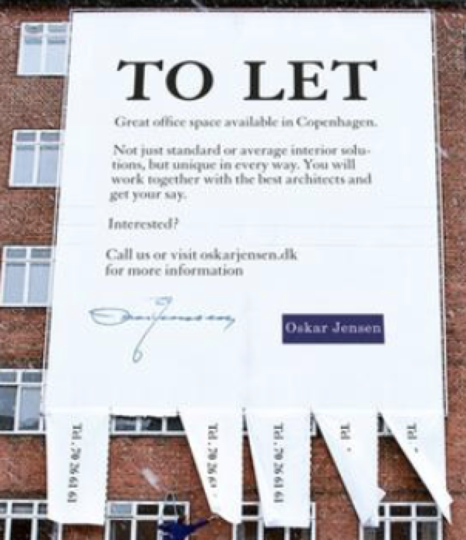
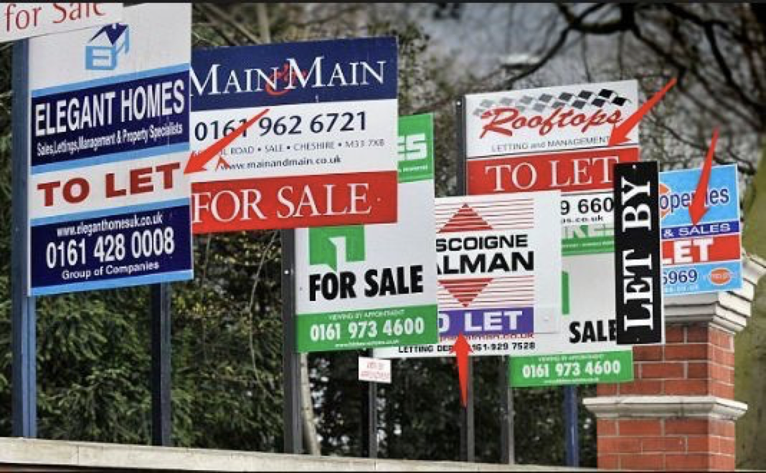
hire a car
hire out a car
hire a lawyer to handle the case
be for hire
rent a car from him
rent (out) a car to him
for rent/ to let
Notes:
to let a field to a farmer

